Slide 1
Summarizing and mining inverse distributions
on data streams
via dynamic inverse sampling
Presented by
Sami Ullah
2017206355

Slide 2
Outline
Defining and motivating the Inverse Distribution
Queries and challenges on the Inverse Distribution
Dynamic Inverse Sampling to draw sample from Inverse Distribution
Experimental Study

Slide 3
Data Streams & DSMSs
Numerous real world applications generate data streams:
IP network monitoring
click streams
Telecommunications
financial transactions
sensor networks
text streams at application level, etc.
Data streams are characterized by massive data volumes of transactions and measurements at high speeds.
Query processing is difficult on data streams:
We cannot store everything, and must process at line speed.
Exact answers to many questions are impossible without storing everything
We must use approximation and randomization with strong guarantees.
Data Stream Management Systems (DSMS) summarize streams in small space (samples and sketches).

Slide 4



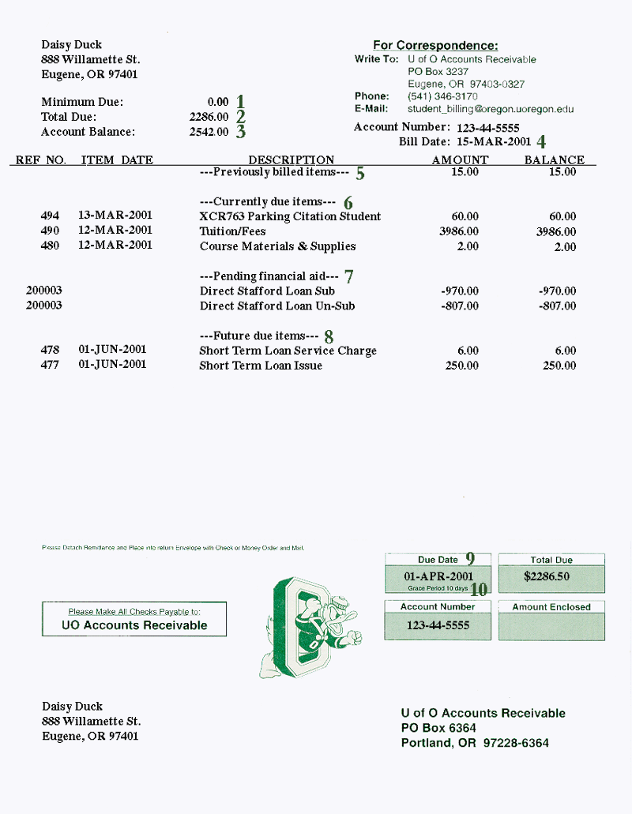
DSMS Application:
IP Network Monitoring
Needed for:
network traffic patterns identification
intrusion detection
reports generation, etc.
IP traffic stream:
Massive data volumes of transactions and measurements:
over 50 billion flows/day in AT&T backbone.
Records arrive at a fast rate:
DDoS attacks - up to 600,000 packets/sec
Query examples:
heavy hitters
change detection
quantiles
Histogram summaries

Slide 5
Forward and Inverse Views
Consider the IP traffic on a link as packet p representing (i_{p}, s_{p}) pairs where i_{p} is a source IP address and s_{p} is a size of the packet.
Problem A.
Which IP address sent the most bytes?
That is , find i such that
∑_{p|ip=i} s_{p} is maximum.
Forward distribution.
Problem B.
What is the most common volume of traffic sent by an IP address?
That is , find traffic volume W
s.t |{i|W = ∑_{p|ip=i} s_{p}}| is maximum.
Inverse distribution.
Notes:
Forward Distribution: Number of occurrences of x in a stream. → item frequency
Reverse Distribution: which is the number of items that appear “i” times. → IPs which sent traffic < 1KB

Slide 6
The Inverse Distribution
If f is a discrete distribution over a large set X, then inverse distribution, f⁻¹(i), gives fraction of items from X with count i.
Inverse distribution is f⁻¹[0…N],
f⁻¹(i) = fraction of IP addresses which sent i bytes.
= |{ x : f(x) = i, i⁻¹≠0}|/|{x : f(x)⁻¹≠0}|
F⁻¹(i) = cumulative distribution of f⁻¹
= ∑_{j > i} f⁻¹(j) [sum of f⁻¹(j) above i]
Fraction of IP addresses which sent < 1KB of data = 1 – F⁻¹(1024)
Most frequent number of bytes sent = i s.t. f⁻¹(i) is greatest
Median number of bytes sent = i s.t. F⁻¹(i) = 0.5
Notes:
For a discrete distribution over large set of IPs
The inverse distribution will result in fraction of IPs that have similar count “i” (size of bytes)

Slide 7
Queries on the Inverse Distribution
Particular queries proposed in networking map onto f⁻¹,
f⁻¹(1) (number of flows consisting of a single packet) indicative of network abnormalities / attack [Levchenko, Paturi, Varghese 04]
Identify evolving attacks through shifts in Inverse Distribution [Geiger, Karamcheti, Kedem, Muthukrishnan 05]
Better understand resource usage:
what is dbn. of customer traffic? How many customers < 1MB bandwidth / day? How many use 10 – 20MB per day?, etc.
→ Histograms/ quantiles on inverse distribution.
Track most common usage patterns, for analysis / charging
requires heavy hitters on Inverse distribution
Inverse distribution captures fundamental features of the distribution, has not been well-studied in data streaming.
Notes:
We can count for a specific packet type; consider an attack like port scan.
This count can help us to detect anomalies in the network
We can better understand resource usage – top browsing trend etc.
But inverse distribution topic is not well studied in data streams. It needs to be explored.

Slide 8
Forward and Inverse Views on IP streams
Consider the IP traffic on a link as packet p representing (i_{p}, s_{p}) pairs where i_{p} is a source IP address and s_{p} is a size of the packet.
Forward distribution:
Work on f[0…U] where f(x) is the number of bytes sent by IP address x.
Each new packet (i_{p}, s_{p}) results in f[i_{p}] ←f[i_{p}] + s_{p}.
Inverse distribution:
Work on f⁻⁻¹[0…K]
Each new packet results in f⁻¹[f[i_{p}]]←f⁻¹[f[i_{p}]] − 1 and f⁻¹[f[i_{p}] + s_{p}]←
f⁻¹[f[i ] + s ]+1.
p p
Problems:
– f(i) = ?
which f(i) is the largest?
quantiles of f ?
Problems:
– f⁻¹(i) = ?
which f⁻¹(i) is the largest?
quantiles of f⁻¹ ?
Notes:
Forward distribution is # of bytes sent by single IP.
Reverse distribution is # of Ips; which sent same volume of traffic.

Slide 9
Inverse Distribution on Streams: Challenges I
7/7
6/7
5/7
4/7
3/7
2/7
1/7
5
4
3
2
1
f(x)
f ⁻¹(x)
F⁻¹(x)
3/7
2/7
1/7
x i
i
1 2 3 4 5
1 2 3 4 5
If we have full space, it is easy to go between forward and inverse distribution.
But in small space it is much more difficult, and existing methods in small space don’t apply.
Find f(192.168.1.1) in small space, with query give a priori – easy: just count how many times the address is seen.
Find f⁻¹(1024) – is provably hard (can’t find exactly how many IP addresses sent 1KB of data without keeping full space).

Slide 10
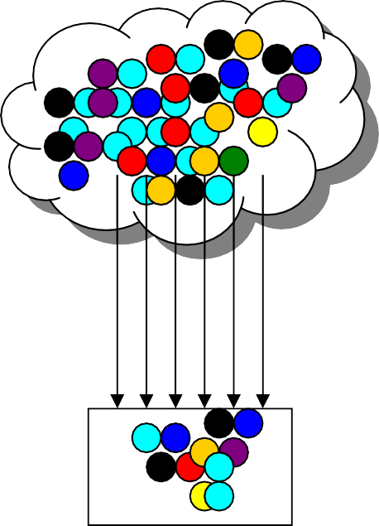
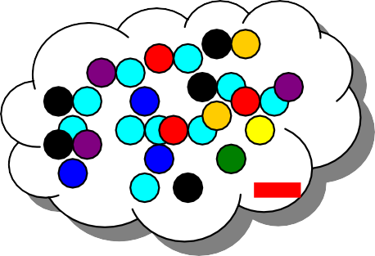
Inverse Distribution on Streams: Challenges II, deletions
How to maintain summary in presence of insertions and deletions?
Insertions only
updates s_{p} > 0
Insertions and Deletions
updates s_{p} can be arbitrary
Stream of arrivals
Stream of arrivals
and departures
+
original distribution
original distribution
How to summarize?
estimated distribution
estimated distribution
Can sample
?
?

Slide 11
Paper Approach: Dynamic Inverse Sampling
Many queries on the forward distribution can be answered effectively by drawing a sample.
Draw an x so probability of picking x is f(x) / ∑_{y} f(y)
Similarly, we want to draw a sample from the inverse distribution in the centralized setting.
draw (i,x) s.t. f(x)=i, i≠0 so probability of picking i is f⁻¹(i) / ∑_{j} f⁻¹(j) and probability of picking x is uniform.
Drawing from forward distribution is “easy”: just uniformly decide to sample each new item (IP address, size) seen
Drawing from inverse distribution is more difficult, since probability of drawing (i,1) should be same as (j,1024)

Slide 12
Dynamic Inverse Sampling: Outline
Data structure split into levels
x count unique
x
l(x)
M
Mr
For each update (i_{p}, s_{p}):
Mr² Mr³
compute hash l(i_{p}) to a level in the data structure.
Update counts in level l(i_{p}) with i_{p} and s_{p}
…
…
0
At query time:
probe the data structure to return (i_{p}, Σ s_{p}) where i_{p} is sampled uniformly from all items with non-zero count
Use the sample to answer the query on the inverse distribution.

Slide 13
Hashing Technique
Use hash function with exponentially decreasing distribution:
Let h be the hash function and r is an appropriate const < 1
x count unique
Pr[h(x) = 0] = (1-r)
Pr[h(x) = 1] = r (1-r)
…
Pr[h(x) = l] = r^{l}(1-r)
x
l(x)
M
Mr
Mr² Mr³
…
…
0
Track the following information as updates are seen:
x: Item with largest hash value seen so far
unique: Is it the only distinct item seen with that hash value?
count: Count of the item x
Challenge:
How to maintain in presence of deletes?
Easy to keep (x, unique, count) up to date for insertions only

Slide 14
Collision Detection: inserts and deletes
sum count coll. detection
x
M
Level 0
l(x)
Mr
update | output
insert 13 | 13/1=13
insert 13 | 26/2=13
insert 7 | collision
delete 7 | 26/2=13
Mr² Mr³
…
…
0
For single location: if sum[l] % count[l] != 0
13
1-2
Simple: Use approximate distinct element estimation routine.

Slide 15








Outline of Analysis
Analysis shows: if there’s unique item, it’s chosen uniformly from set of items with non-zero count.
Can show whatever the distribution of items, the probability of a unique item at level l is at least constant
Use properties of hash function:
– only limited, pairwise independence needed (easy to obtain)
Theorem: With constant probability, for an arbitrary sequence of insertions and deletes, the procedure returns a uniform sample from the inverse distribution with constant probability.
Repeat the process independently with different hash functions to return larger sample, with high probability.
Level l

Slide 16
Application to Inverse Distribution Estimates
Overall Procedure:
Obtain the distinct sample from the inverse distribution of size s;
Evaluate the query on the sample and return the result.
Median number of bytes sent: find median from sample
The most common volume of traffic sent: find the most common from sample
What fraction of items sent i bytes: find fraction from the sample
Example:
Median is bigger than ½ and smaller than ½ the values.
Answer has some error: not ½, but (½ ± ε)
Theorem: If sample size s = O(1/ε² log 1/δ) then answer from the sample is between (½-ε) and (½+ε) with probability at least 1-δ.
Proof follows from application of Hoeffding’s bound.

Slide 17
Experimental Study
Data sets:
Large sets of network data drawn from HTTP log files from the 1998 World Cup Web Site (several million records each)
Synthetic data set with 5 million randomly generated distinct items
Used to build a dynamic transactions set with many insertions and deletions
(DIS) Dynamic Inverse Sampling algorithms – extract at most one sample from each data structure
(GDIS) Greedy version of Dynamic Inverse Sampling – greedily process every level, extract as many samples as possible from each data structure
(Distinct) Distinct Sampling (Gibbons VLDB 2001) draws a sample based on a coin-tossing procedure using a pairwise-independent hash function on item values

Slide 18
Sample Size vs. Fraction of Deletions
Desired sample size is 1000.
data: synthetic data size: 5000000
1400
1200
1000
800
600
400
200
0
Distinct
DIS
actiual sample size
0
20
40 60
fraction of deletions (%)
80
100

Slide 19
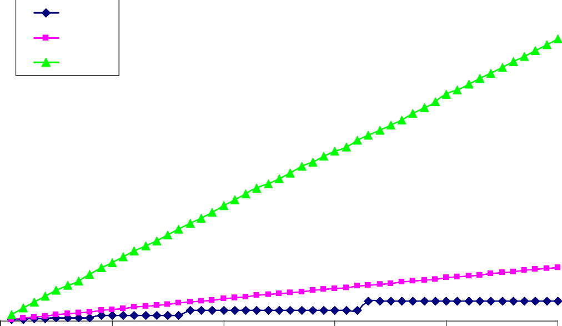
Returned Sample Size
Experiments were run on the client ID attribute of the HTTP log data. 50% of the inserted records were deleted.
data: WorldCup98 data size: 2266137
6000
Distinct
5000
DIS GDIS
actual sample size
4000
3000
2000
1000
0
0
200
400 600
desired sample size
800
1000

Slide 20
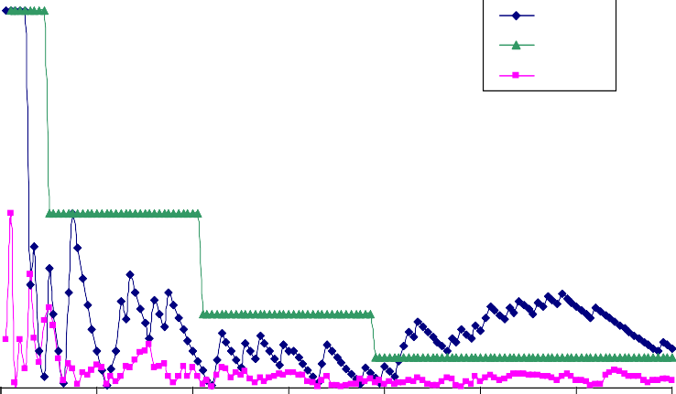
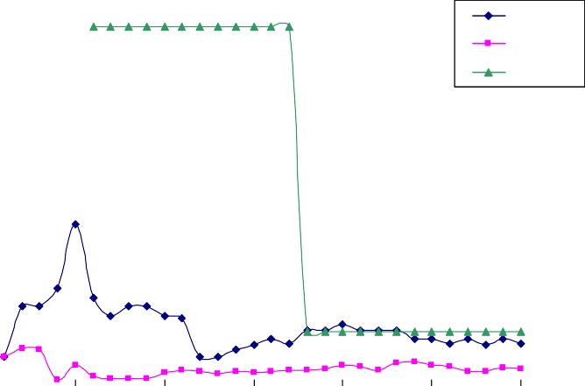
Sample Quality
Inverse range query:
Compute the fraction of records with size greater than i=1024 and compare it to the exact value computed offline
Inverse quantile query:
Estimate the median of the inverse distribution using the sample and measure how far was the position of the returned item i from 0.5.
data: WorldCup98 data size: 2266137
data: WorldCup98 data size: 4849706
0.25
0.6
0.5
DIS GDIS
Distinct
DIS
0.2
Distinct GDIS
quality error
0.15
quality error
0.4
0.3
0.2
0.1
0
0.1
0.05
0
60 80
sample size
0
100
200
300 400
sample size
500
600
700
0
20
40
100
120
140

Slide 21
Conclusions
We have formalized Inverse Distributions on data streams and introduced Dynamic Inverse Sampling method that draws uniform samples from the inverse distribution in presence of insertions and deletions.
With a sample of size O(1/ε²), can answer many queries on the inverse distribution (including point and range queries, heavy hitters, quantiles) up to additive approximation of ε.
Experimental study shows that proposed methods can work at high rates and answer queries with high accuracy

Slide 22
Q & A

